Slide 1
Hash function
How program run make things fast

Slide 2
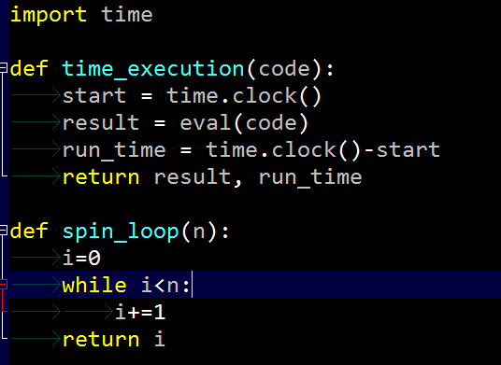


1. Stop watch
Note: eval()
>>x = 1
>>eval(‘x+1’)
2
Running time is LINEAR
in the magnitude of n

Slide 3
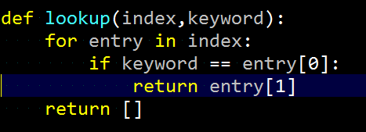
1.1 lookup(index, keyword)
Index = [[[ key, [url1, url2,…]],
[ key, [url1,url2,…]],
…
]
Our lookup fast ?
Depend on how many
keywords
lookup

Slide 4
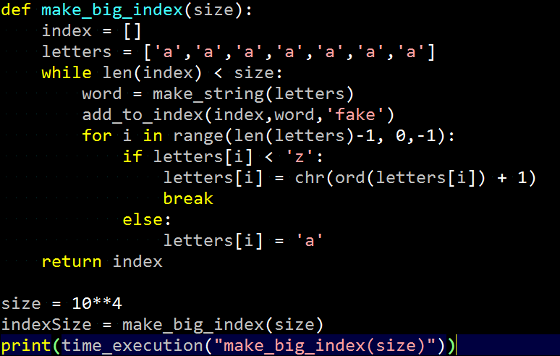
1.2 Try to lookup a big index
~7 sec
make_big_index.py

Slide 5
2. How can we make lookup faster
‘a’
‘b’
‘udacity’
…
keyword
hash
‘udacity’
…
‘u’
…
bucket
Hash table
…
Dictionary
‘union’
…

Slide 6
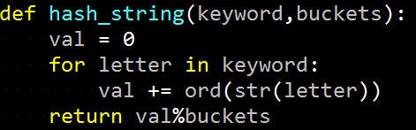

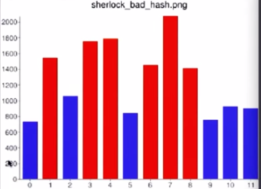
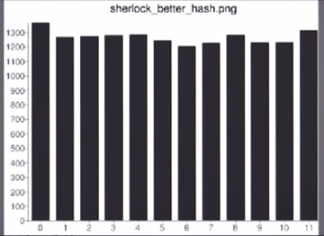
2.1 hash_string
Define a function, hash_string, that takes as inputs a keyword (string) and a number of buckets, and returns a number representing the bucket for that keyword.

Slide 7

2.2 Creating an empty Hash Table
Define a procedure, make_hashtable, that takes as input a number, nbuckets and output an empty hash table with nbuckets empty buckets.

Slide 8

2.3 Get bucket from keyword
Define a procedure, hashtable_get_bucket, that takes two inputs - a hashtable, and a keyword, and returns the bucket where the keyword could occur.

Slide 9
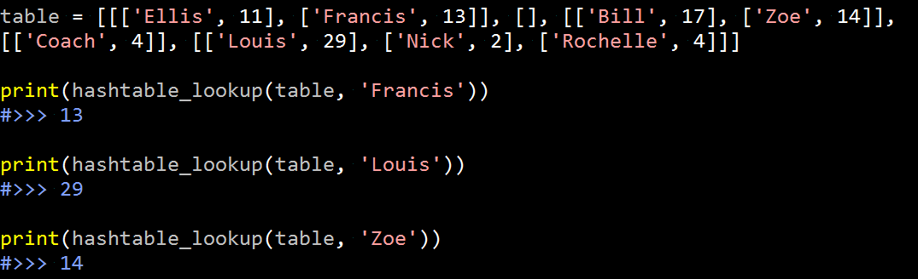
2.4 Lookup in hashtable
Define a procedure, hashtable_lookup(htable,key) that takes two inputs, a hashtable and a key (string), and returns the value associated with that key.

Slide 10
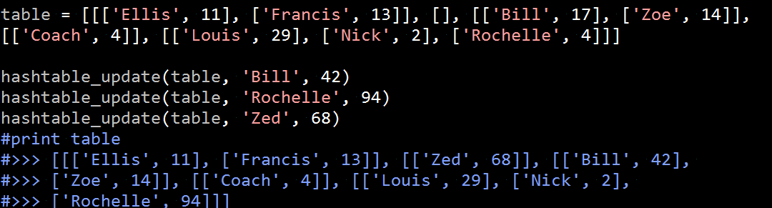
2.5 Update hashtable
Define a procedure, hashtable_update(htable,key,value) that updates the value associated with key. If key is already in the table, change the value to the new value. Otherwise, add a new entry for the key and value.
Hint: Use hashtable_lookup as a starting point.

Slide 11


3. Dictionary
Hash function in python.
Syntax: {}

